Slide 1




Newborn Genetic Disorder Screening via DNA Motif Scanning
Data Structures and Algoritms - 3

Slide 2


Team Members
  2520030039 - T.S.S.S.Ananya
  2520030095 - Thipireddy Hansini
  2520030155 - Fathima Qhibtiya Khader

Slide 3



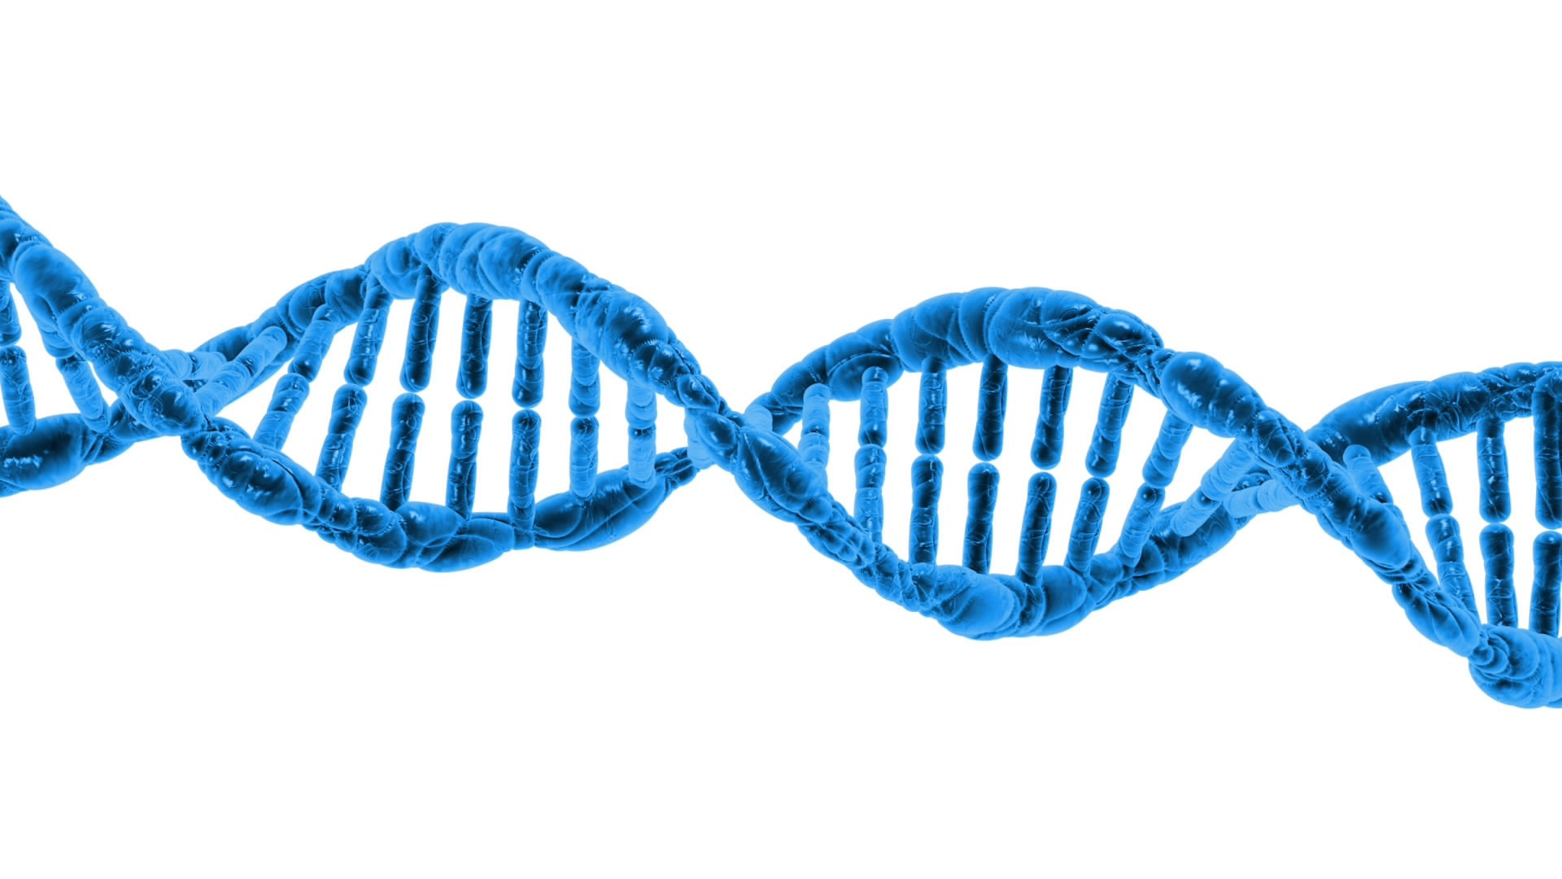
Abstract
Genetic screening for newborns and carriers is expanding rapidly worldwide to detect inherited disorders before symptoms appear, enabling early, life-saving medical intervention. In India, initiatives like the National Sickle Cell Anaemia Elimination Mission target major genetic burdens, including Sickle Cell Disease and Beta-thalassemia, which are caused by specific, well-documented mutations in the HBB gene. As these screening programs grow, they are transitioning from checking a single condition to checking dozens of disorders simultaneously. Because DNA is a string composed of a four-letter alphabet (A, C, G, T), identifying these genetic markers within a patient sample is fundamentally a multi-pattern string matching problem.

Slide 4

Problem Statement
The traditional, naive approach to multi-pattern matching is to search the DNA sample sequentially for each genetic marker, one at a time. Using standard single-pattern algorithms like Knuth-Morris-Pratt (KMP) means the entire DNA sample must be re-read from scratch for every condition added to the testing panel.
Consequently, the computational cost and processing time grow linearly with the number of disorders checked. This poor scaling behavior makes sequential searching highly inefficient and unsustainable for modern healthcare programs that continuously expand their screening panels.

Slide 5
Methodology
This project resolves the scaling bottleneck by modeling the screening engine around the Aho–Corasick algorithm as the core solution, using a sequential Knuth–Morris–Pratt (KMP) algorithm as a baseline for empirical comparison.
  Aho–Corasick Engine: The system inserts every disease marker from the panel into a specialized trie optimized for the 4-symbol DNA alphabet. A breadth-first search then constructs "failure links" across the tree, converting the trie into a single finite-state automaton. This allows the engine to scan the entire newborn DNA sample in a single pass. The processing time remains independent of the number of markers in the panel.
  KMP Baseline: A sequential KMP search is implemented to run alongside the core engine, searching for each marker independently to generate benchmark data and empirically prove the scaling advantage of the automaton.
  Data and Scope: The system uses public HBB reference gene sequences with synthetically introduced pathogenic variants for testing, ensuring no real patient genomic data is required. It is designed as a fast, first-pass screening layer that outputs structured, clinician-readable reports rather than raw match positions, supporting incremental panel updates without re-scanning previously processed samples.

Slide 6
Expected Outcome
  A working Java-based screening engine that ingests a DNA sample and a marker panel, and returns a clinician-readable report identifying all matched conditions in a single pass, regardless of panel size
  Empirical benchmark data (graphs/tables) demonstrating that Aho-Corasick scan time stays flat/near-constant as panel size grows, while KMP baseline scan time grows linearly — this is the core proof-of-concept result
  A reusable, panel-agnostic architecture: adding the 41st marker costs the same as the 1st, in contrast to sequential approaches
  Demonstrated correctness: both engines agree on match results for identical inputs, validating the automaton's accuracy against the trusted baseline
  A functioning demo (dashboard + sample report) suitable for hackathon presentation, showing the "single scan vs sequential scan" advantage visually.

Slide 7
Proposed Functionalities
1. Marker Panel Management
  Add/remove/update disease markers (mutation signatures) in the screening panel without rebuilding the entire system from scratch
  Support incremental automaton updates so a new marker doesn't require re-scanning already-processed samples
  Store marker metadata: disease name, associated gene, mutation type (point mutation, deletion, insertion), clinical severity/urgency tag
2. Dual-Engine Matching Core
  Aho-Corasick engine: trie construction → BFS failure-link construction → single-pass automaton scan of the DNA sample
  KMP baseline engine: sequential per-marker scan, used strictly as a performance comparison baseline, not for production screening
  Both engines should output identical match sets (marker ID, position, matched substring) so correctness can be cross-validated.

Slide 8
Proposed Functionalities
3. Benchmarking & Scaling Analysis Module
  Automatically run both engines on the same sample across increasing panel sizes (e.g., 5, 10, 20, 40, 80 markers)
  Log execution time, memory footprint, and comparisons/operations count
  Auto-generate a scaling graph (time vs. panel size) showing linear growth for KMP vs. flat/near-constant growth for Aho-Corasick
4. Clinician-Readable Report Generator
  Convert raw match positions into structured output: condition name, gene, confidence/match quality, position in reference gene, recommended next step (e.g., "confirmatory test recommended")
  Export as PDF/structured JSON, not raw match dumps
  Flag multiple co-occurring conditions distinctly (important for compound heterozygous cases like Sickle Cell + Beta-thalassemia)

Slide 9
Proposed Functionalities
5. Synthetic Data Generator
  Module to take a public HBB reference sequence and inject synthetic pathogenic variants at controlled positions/frequencies, so the system can be tested without real patient data and with reproducible test cases
6. Visualization Dashboard
  Show trie/automaton structure for demo purposes
  Show live scan progress and match highlights against the reference sequence

Slide 10
Future Scope
  Approximate/fuzzy matching: extend Aho-Corasick to tolerate SNPs or sequencing errors (e.g., via Aho-Corasick + edit-distance hybrid, or Bitap-style approximate matching) since real sequencing reads aren't always perfect
  Expand beyond HBB: generalize the panel to other well-characterized single-gene disorders (e.g., CFTR for Cystic Fibrosis, G6PD deficiency) to move toward a true multi-disorder newborn panel
  Parallelization: multi-threaded scanning for whole-genome-scale inputs rather than single-gene reference sequences
  Integration with real screening pipelines: FASTQ/BAM file format support instead of raw string input, aligning with actual lab workflows
  Cloud/edge deployment: package as a microservice so district-level health centers can query a centralized panel without needing local compute power
  Regulatory alignment: design report format to align with ICMR/NSCAEM reporting standards for future real-world pilot use.

Slide 11
Software Requirements
Software Required | Software Used
Programming Language | Java
IDE + Compiler | Visual Studio
Data Source | NCBI/Ensembl public HBB reference sequences (FASTA format)
Backend + API + Frontend | SQLite/PostegreSQL FastAPI or Flask React
Version Control | Git & GitHub

Slide 12
Thank You

